Slide 1
Brugada Syndrome

Slide 2
Does this patient with Brugada ECG need an ICD?

Slide 3
Clinical Features and Epidemiology
First described in 1992
Characterized by an aberrant pattern of ST segment elevation in right precordial leads and a high incidence of sudden death in patients with structurally normal heart
4 - 12% of all sudden death and 20% of sudden death in patients with structurally normal heart
Leading cause of death of men under age 40 in regions where the inheritance is endemic

Slide 4
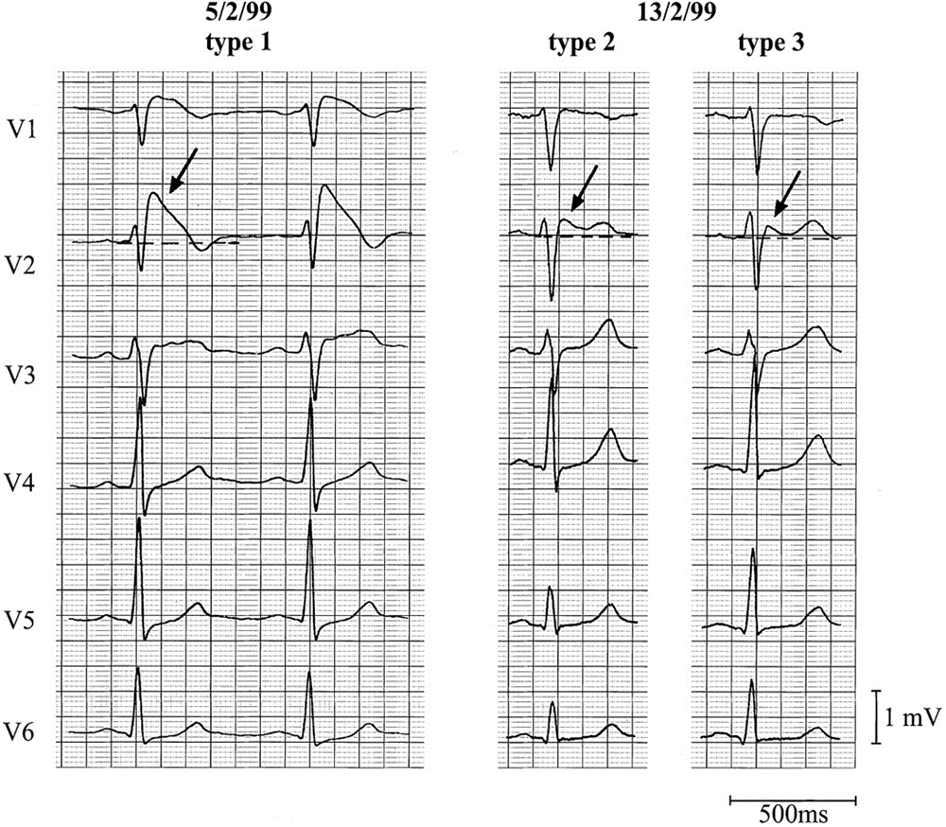

Slide 6
Clinical Features and Epidemiology
Incidence estimated to be in the order 5 /10000(as high as 1/2000)
True prevalence in general population is difficult to estimate as ECG pattern can be dynamic and concealed
Much higher in Asian, Southeast asian countries especially Thailand, Philipines , and Japan

Slide 7
Clinical Features and Epidemiology
Typical age of onset at 30-40 (mean age of SCD 41 ± 15 years)
Male : female ratio - 8:1 (Clinical manifestation )
Percentage of clinically affected patients with at least 1 cardiac arrest before age 60 is only 10-15% (in contrary to early beliefs)
Typically cardiac events (syncope and SCD) manifest at rest, during sleep and may be triggered by hyperpyrexia, large meals, excessive alcohol

Slide 8
Clinical Features and Epidemiology
Approximately 20% of BrS patients develop SVT
AF is associated in 10-20% of cases
Incidence of atrial arrhythmias is higher in patients with ICD indication (27% vs 13% P<0.05), causing inappropiate shocks in 14% of ICD patients

Slide 9
Clinical Features and Epidemiology
Inheritance - autosomal dominant with incomplete penetrance
The first gene - SCN5A on chromosome 3 (encodes for the alpha subunit of the cardiac Na channel)
>80 mutations in SCN5A have been linked to the syndrome since 2001.
All consequence of these mutations is to produce a reduction of Na current
  Failure of Na channel to express
  Shift in the voltage and time dependence of activation, inactivation and reactivation
  Slow recovery of the Na channel from inactivation
  Accelerated inactivation of the Na channel
Only less than 20% of clinically diagnosed BrS are accountable by SCN5A mutations

Slide 10
Diagnostic Criteria of Brugada Syndrome
Appearance of on a type 1 ST segment elevation (coved type) ≥ 2mm in >1 right precordial lead (V1-3)
  (either spontaneously or after Na channel blocker exposure)
AND
One of the following:
  Documented VF
  (Self-terminating) polymorphic VT
  Inducibility of ventricular arrhythmias with programmed electrical stimulation
  Family history of sudden death before age 45
  Presence of of a coved-type ECG in family members
  Syncope
  Nocturnal agonal respiration
Other factors accounting for the ECG abnormality should be ruled out

Slide 11
Brugada syndrome: Diagnosis
type 2 or type 3 ST segment elevation in >1 right precordial leads under baseline conditions with conversion to type 1 following challenge with a Na channel blocker is considered positive
One or more of the clinical criteria should also be present
Drug induced ST elevation to <2mm is considered inconclusive
Drug-induced conversion of type 3 to type 2 ECG pattern is considered inconclusive

Slide 12
Drugs used to unmask Brugada syndrome
Ajmaline 1mg/kg over 5min. IV
Flecainide 2mg/kg over 10 min. IV (max 150mg)
Procainamide 10mg/kg over 10min. IV
Pilsicainide 1mg/kg over 10min. IV
Penetrance of BrS phenotype increase from 32.7% to 78.6% with the use of Na channel blocker.
Flecainide : Sens 77%, Spec 80%, PPV 96%, NPV 36%
(Meregalli et al. J Cardiovas Electrophysiol 2006; 17:857-864)
Ajmaline: Sens 80%, Spec 94.4%, PPV 93.3%, NPV 82.9%
(Hong et al. Circulation 2004; 110:3203-7)

Slide 13
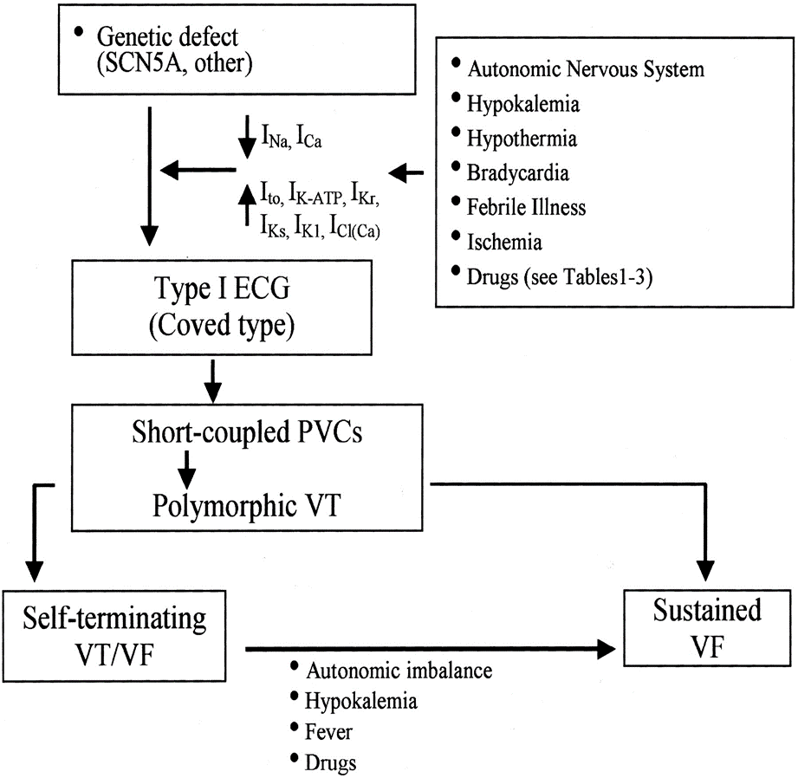
Modulating and Precipitating factors

Slide 14
Therapeutic recommendation for Brugada syndrome
ICD is the only proven effective treatment of BrS.
Drugs reported to exacerbate the ECG pattern of ST segment elevation and trigger arrhythmias in BrS should be avoided. (Brugadadrugs.org)
  Antiarrhythmics (class Ia Ic betablockers), CCB, nitrates, TCA, phenothiazines, SSRI like fluoxetine, bupivacaine, propoxyphene, propofol, pinacidil, nicorandil (K channel activators), Li, cociane, methoxamine (alpha- agonists)
Avoid excessive alcohol, large carbohydrate meal, very hot baths, hypokalemia
Hyperpyrexia should be treated promptly

Slide 15
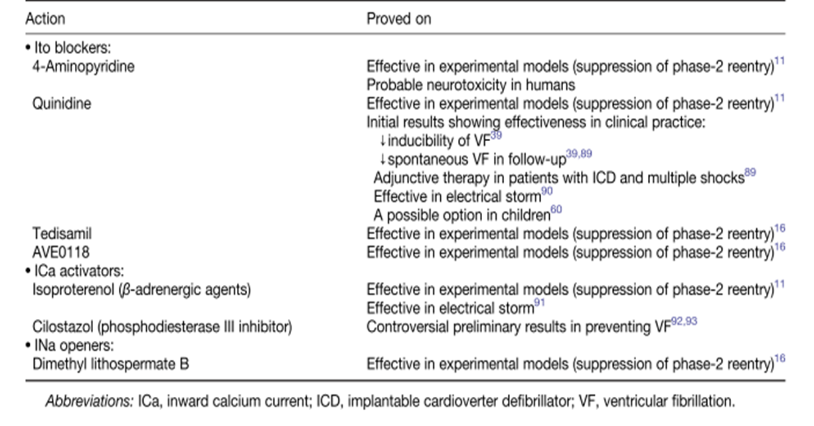
Pharmacological approach to therapy of Brugada syndrome

Slide 16
Case 1
Male, age 61, doctor
History of hypertension and hyperlipidemia
Good exercise tolerance with frequent jogging
Attended ER for epigastric pain for 1 day without radiation
Fever for 1 day
No angina or palpitation or CHF symptom
Stable hemodynamics and no heart failure
Not septic
No acute abdomen

Slide 17
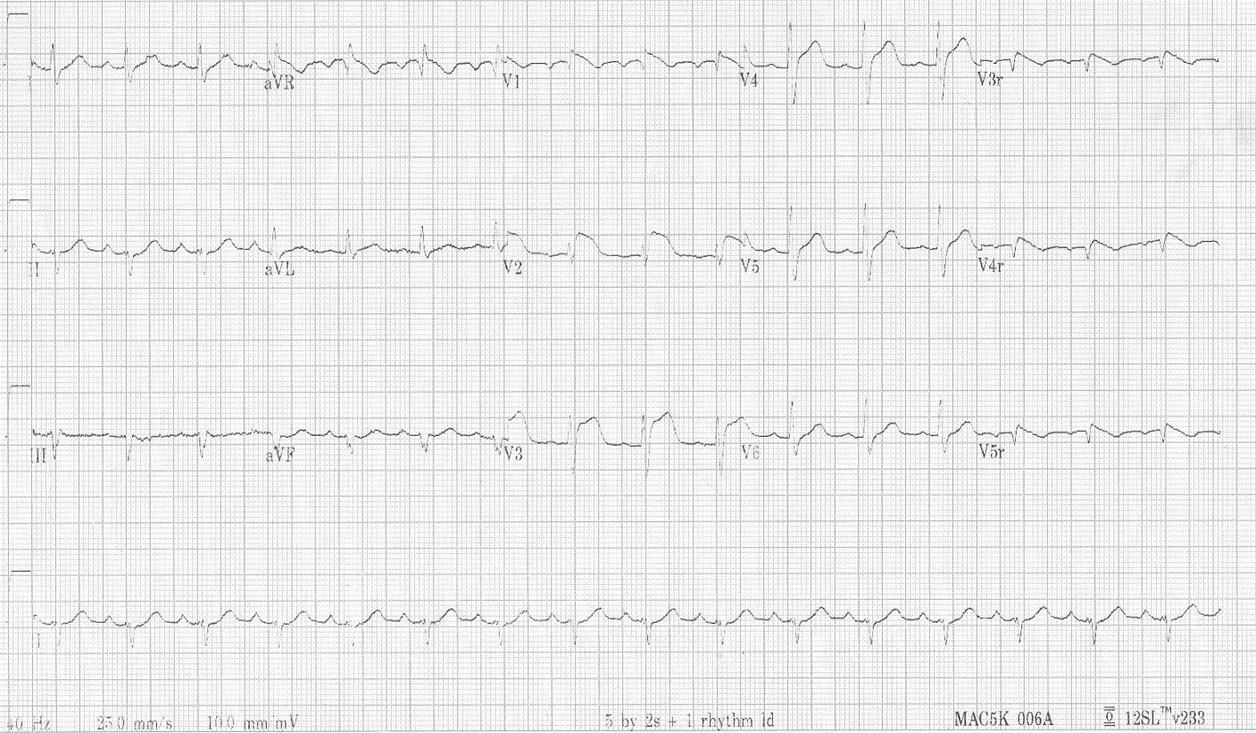
ECG (1)

Slide 18
Blood tests
TC 10800, increased PMN, Hb 16.6
Deranged liver biochemistry: ALT 544 ALP 142 Bil 67. amylase normal
Normal renal biochemistry except K 3.1. normal Ca and Mg level
cTnI <0.03
CRP 45

Slide 19
Echocardiogram showed no segmental wall motion abnormality and LVEF 60%. No pericardial effusion
In the benefit of doubt, the patient was transferred to Cath lab for coronary angiogram to rule out acute coronary occlusion
Coronary angiogram reported only minor lesions: mid LAD 20%, Diag 40% LCX 20%

Slide 20
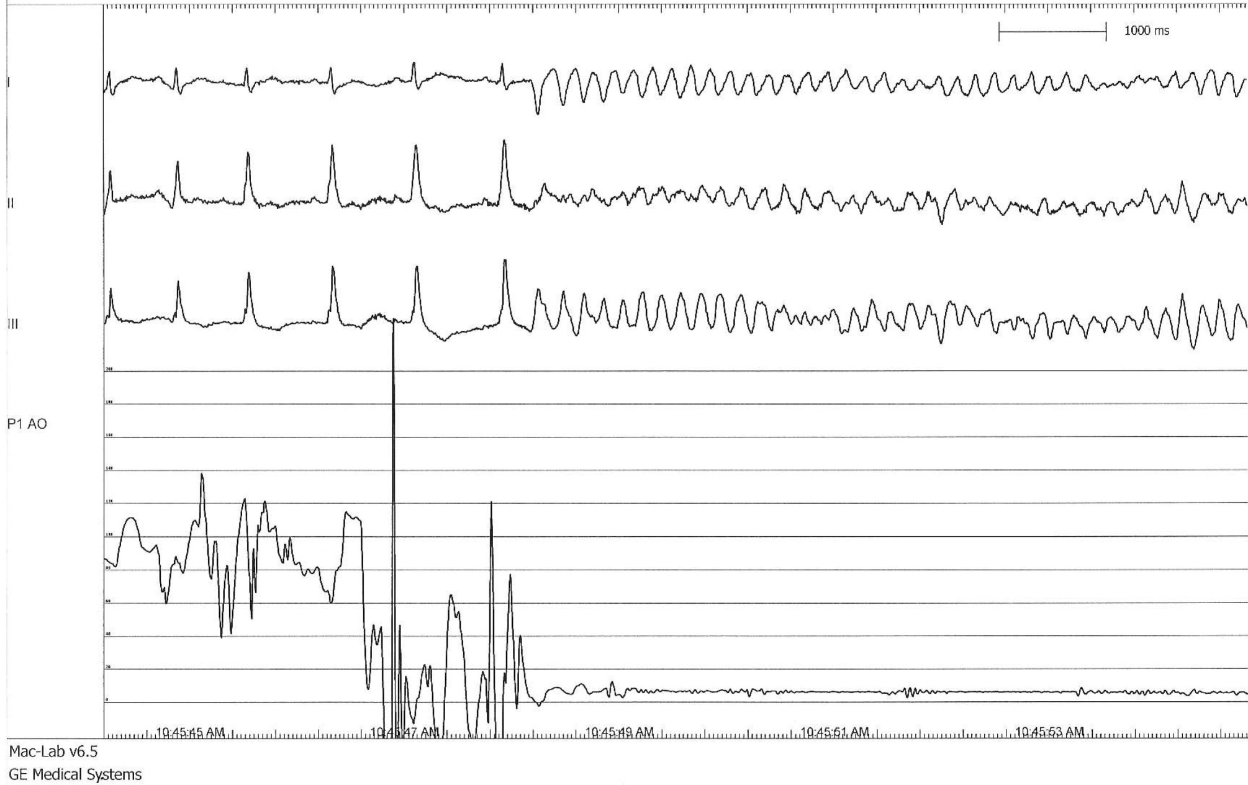
Soon after disengagement of catheters….

Slide 21
His medications included amlodipine and atorvastatin only
His source of sepsis eventually turned out to be biliary in origin. USG and CT abdomen revealed gallbladder sludge. ERCP revealed a little dilated sphincter at CBD but no stone, and bile recovered E.Coli.
Relapsing fever and liver function derangement eventually resolved after stenting at CBD and antibiotics.

Slide 22
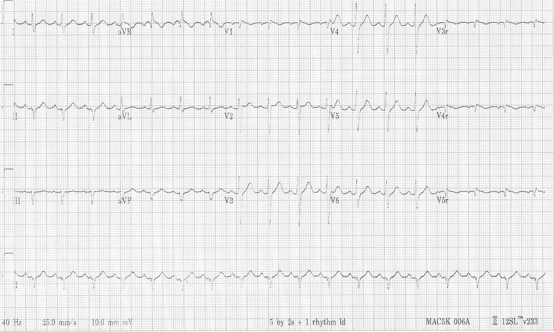
ECG 2

Slide 23
In this case
Brugada ECG pattern type I spontaneous
Aborted sudden death
documented PMVT/VF
During febrile illness
No previous history of recurrent syncope or SCD
No Family history of BrS, BrP or SCD

Slide 24
Management
AICD implantation for secondary prevention of SCD
Avoid provocative drugs
Prompt treatment of febrile episode
Surgery for his gallbladder sludge to avoid recurrent biliary sepsis

Slide 25
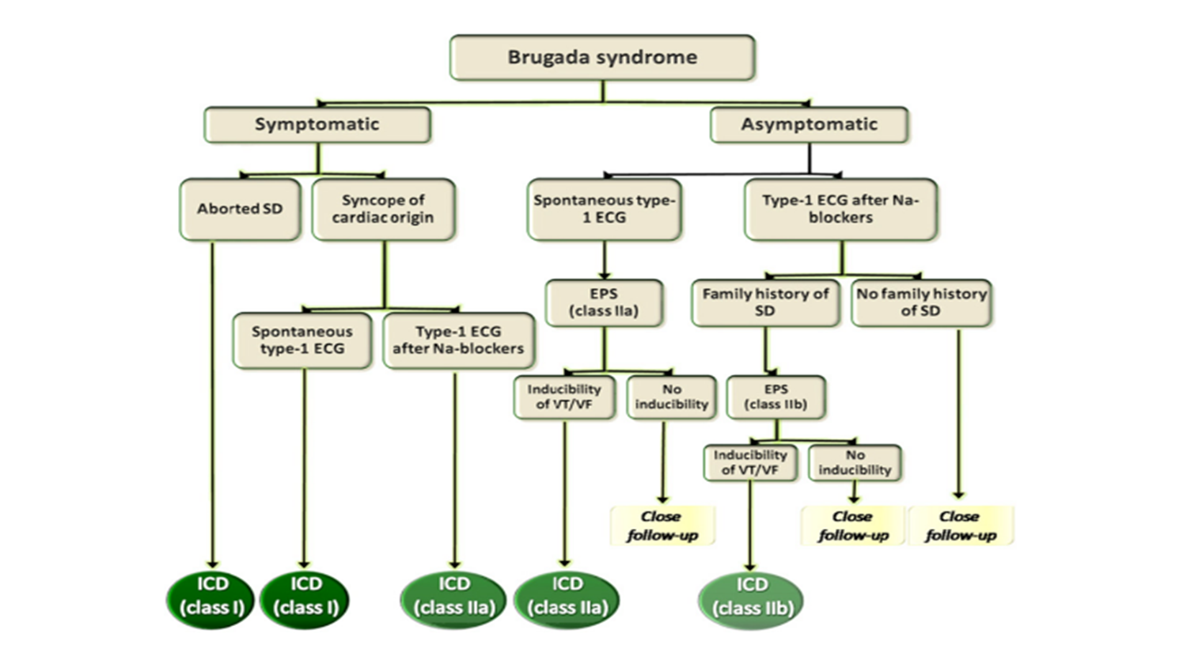
Indication for ICD in patients with Brugada syndrome
Report of 2nd Consensus Conference (2005)

Slide 26
Indication for ICD in patients with Brugada syndrome
Report of 2nd Consensus Conference (2005)

Slide 27
Clear consensus for secondary prevention
Little controversy exists on the value of a previous cardiac arrest as a risk marker for future events.
Data from Brugada et al. (Circulation 2002) reported 62% of SCD survivors are at risk for a new arrhythmic event in the following 54 months.
Other groups consistently reported high annual event rate in SCD survivors:
  Eckardt et al. 2005: 5.1%
  Kamakura et al. 2009: 10.2%
  FINGER registry 2010: 7.7%

Slide 28
In all the analysis of Dr. Brugada’s series (1998, 2002, 2003), several clinical variables predict a worst outcome:
  Presence of symptoms before diagnosis
  Spontaneous type 1 ECG at baseline
  Inducibility of ventricular arrhythmia by programmed stimulation (EPS)
  Male gender

Slide 29
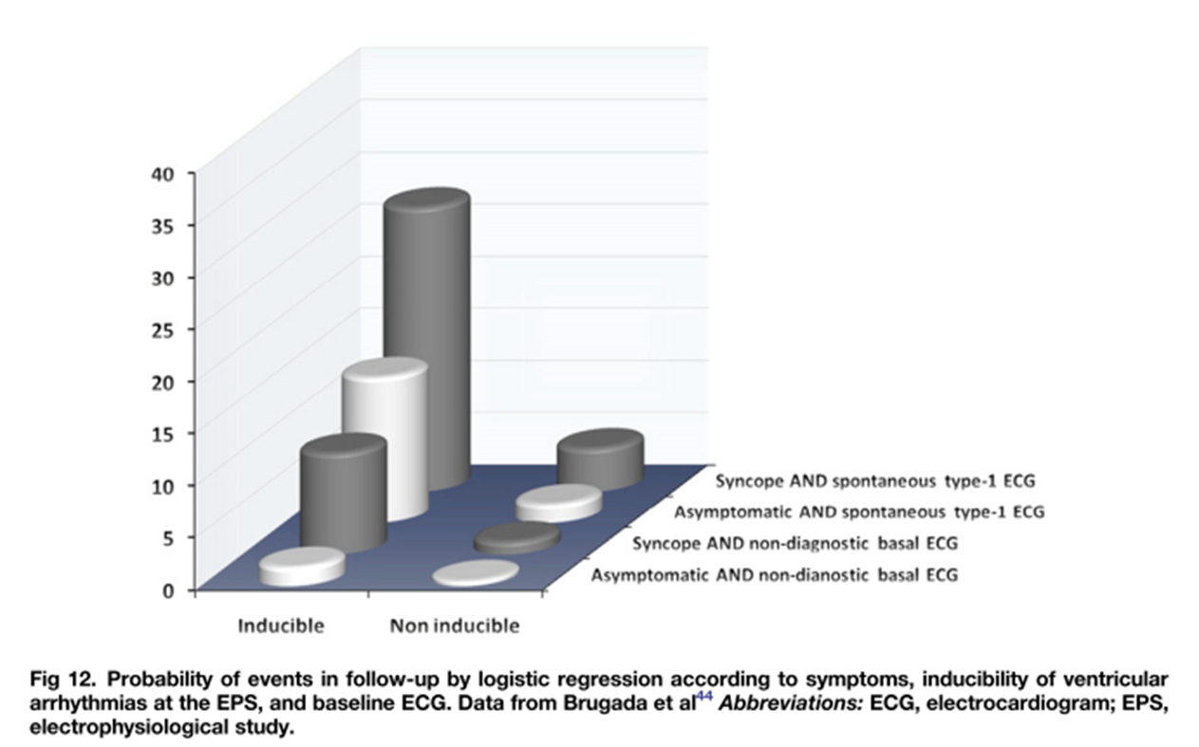
Prognostic model by Brugada group

Slide 30
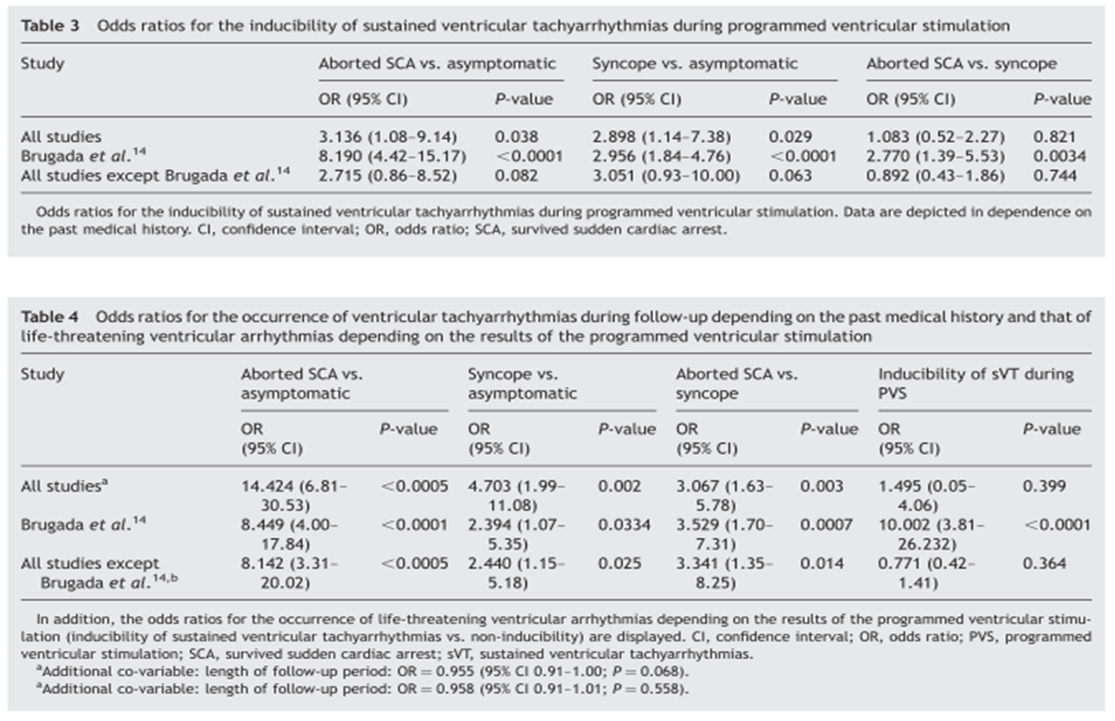
Failure to support the role of EPS in other studies except Brugada’s registry :
Meta-analysis of 15 studies (Paul et al. Eur Heart J 2007 )

Slide 31
Gehi et al. 2006
  Meta-analysis of 30 prospective studies (n=1545, average FU 32 mo)
  History of syncope or SCD
  Spontaneous type 1 brugada ECG
  Male gender
  Family history of SCD
  SCN5A gene mutation
  Inducibility by EPS
FINGER registry, Probst et al. Circulation 2010 (n=1029, median FU 31.9 mo)
  Symptom and spontaneous type 1 ECG - predictors of arrhythmic events
  Gender, family history of SCD, inducibility by EPS, and SCN5A mutation - not predictive
predicts outcome
Not predict outcome

Slide 32
Case 2
Male age 73 retired GS
Hyperlipidemia, DM on diet, Gout.
Hx of Syncope since 2010. Baseline ECG and holter unremarkable
Admitted for syncope and flu-like Sx, sorethroat and fever for 1 day.
Clarified with wife: Near-syncope after lunch sitting upright on couch. Cold sweating, nausea and then vomiting. Brief episode with spontaneous recovery. Neurologically intact.
Abnormal ECG was noted by ER physician

Slide 33
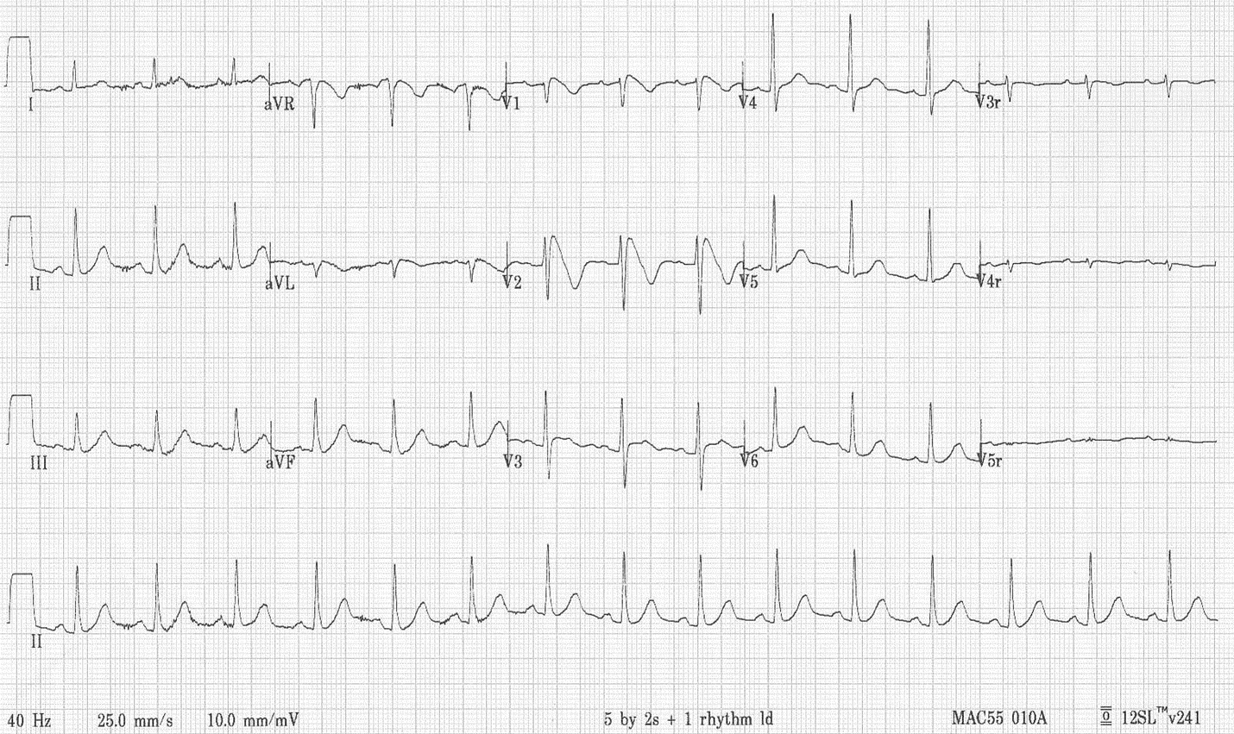
ECG on presentation

Slide 34
Cardiologist was called upon by ER for ?STEMI.
Echocardiogram at bedside revealed normal LVEF with no segmental wall motion abnormality.
The ECG was recognized as type I Brugada pattern.
He was transferred to CCU and put under telemetry monitor.
TnI in serial normal <0.03 ng/mL
Blood biochemistries including Ca and Mg, cell counts, thyroid function all normal

Slide 35
There was no further episode of syncopal attack and no ventricular/supraventricular arrhythmia were documented.
He did not have any angina all along.
He did give a history of 3-4 syncope episodes in the past
His drug history included only aspirin and statin.
No family history of SCD or inherited arrhythmia disorders
Fever was treated with antipyretic and ice pad. Rx as URI.
ECG returned to normal after the febrile illness.

Slide 36
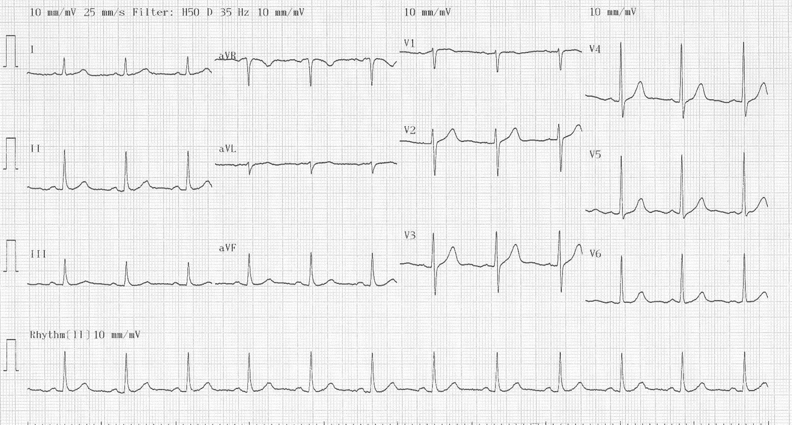
ECG (2) as fever subsided

Slide 37
CT angiogram reported a moderate to severe mid LAD lesion

Slide 38
In this case
Male age 73
Type I brugada ECG pattern during febrile illness
History of recurrent syncope ?mechanism
No documented VT/VF
Concomitant coronary artery disease but normal LVEF and cardiac structures
No Family history of BrS, BrP or SCD

Slide 39
Discussion was held with patient:
  1. Brudaga syndrome with recurrent syncope
  2. incidental finding of mid LAD stenosis not accountable for the presentation and ECG findings.
For ICD implantation followed by coronary angio and PCI after hemostasis of device pocket secured

Slide 40
Indication for ICD in patients with Brugada syndrome
Report of 2nd Consensus Conference (2005)

Slide 41
Cause of Syncope in BrS patient: unresolved dilemma
It is not always easy to delineate the cause of syncope in a patient including those with the Brugada phenotype.
Identification of other causes of syncope in a BrS patient inevitably pose an uncomfortable and unsettled clinical dilemma

Slide 42
Vasovagal syncope vs BrS : coexistence
Neurally mediated syncope and Brugada syndrome share common pathophysiological mechanism particularly sympatho-vagal imbalance.
High incidence of neurally mediated susceptibility (positive Head-up Tilt test) has been demonstrated in asymptomatic subjects with Brugada pattern. (Letsas et al. PACE 2008)

Slide 43
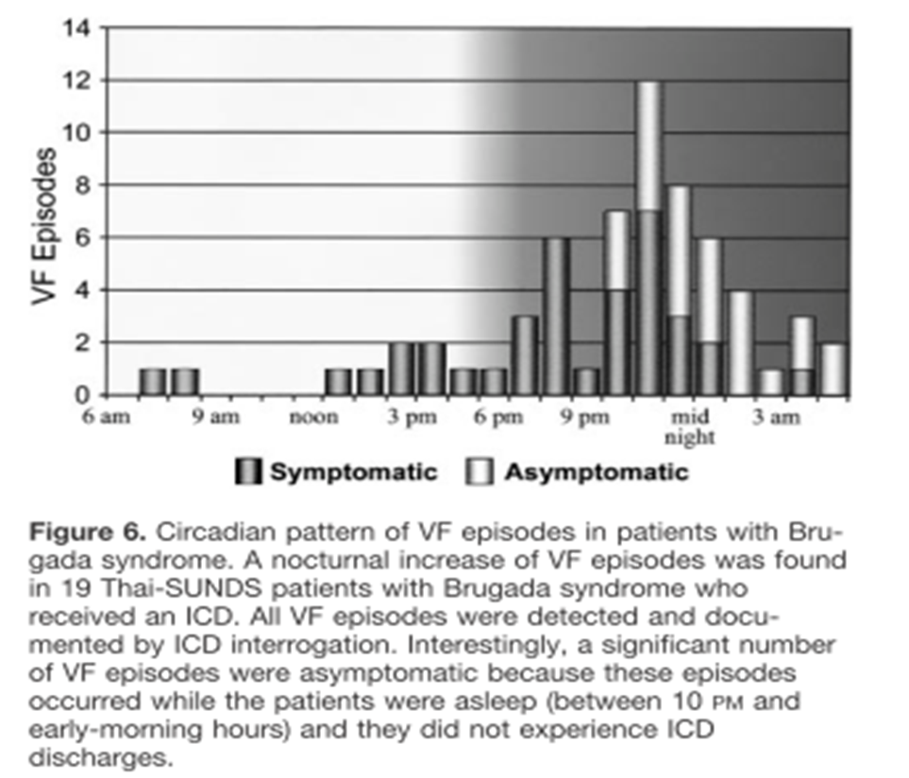

Slide 44
Do no harm is not always easy
Overprotecting a patient with vasovagal syncope and Brugada pattern with ICD?
vs
just accepting a vasovagal origin for all syncope episode: a false sense of security?

Slide 45
Case 3
45 year old man referred for abnormal ECG : ??Brugada pattern.
Apparently healthy. Good exercise tolerance.
No history of recurrent syncope/presyncope/ palpitation
No CHF / anginal symptom
No family history of SCD / Brugada pattern or syndrome or other arrhythmic syndrome
No remarkable drug history or exposure to herb

Slide 46
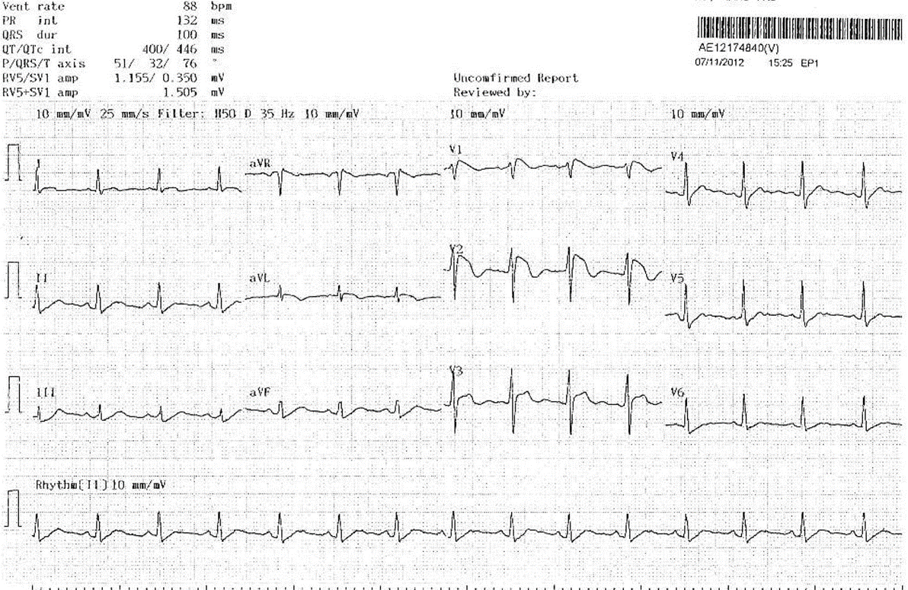
ECG

Slide 47
Holter screening reported no ventricular arrhythmia except from isolated PVC and PAC of <2%.
Exercise ECG testing negative for ischemic change. No augmentation of ST segment elevation during exercise or recovery. 10.1 METS. No symptom produced.
Echocardiogram showed normal chambers sizes and function, normal valvular function
CT coronary angiogram showed only minor lesion with normal coronary origin.
Blood tests showed normal biochemistries.

Slide 48
In this case
Middle age male with Brugada ECG pattern
?spontaneous ?during febrile episode
Asymptomatic without history of SCD / syncope
No documented ventricular arrhythmia
No family history of SCD / arrhythmia syndromes
No other structural or metabolic cause for the ECG change

Slide 49
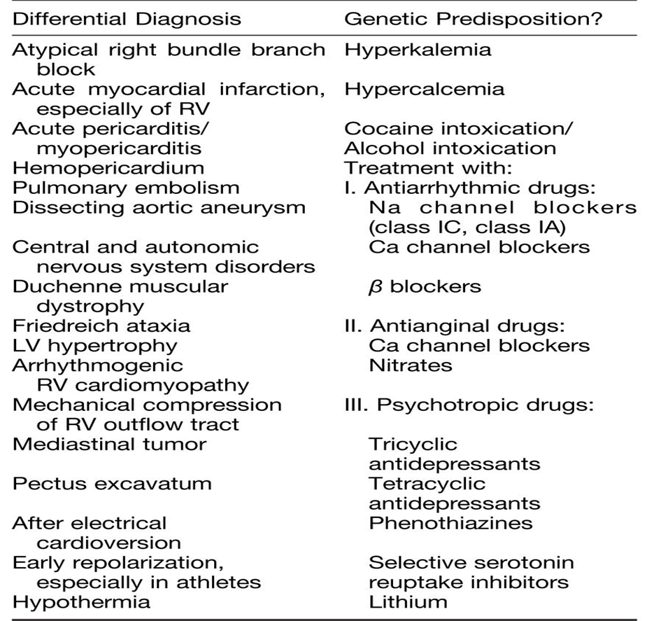
DDx of Brugada pattern (ST elevation in V1-3)

Slide 50
Indication for ICD in patients with Brugada syndrome
Report of 2nd Consensus Conference (2005)
Role of EP Study

Slide 51
Questionable role of EPS for risk stratification
All the studies published since the 2005 consensus have failed to show a prognostic impact from inducibility of ventricular arrhythmia.
PRELUDE registry (Prioi et al. JACC 2012) (n=308 median FU 34 mo)
  VT/VF inducibility by programmed electrical stimulation - unable to predict event
  Spontaneous type 1 ECG
  History of syncope
  VERP <200ms
  QRS fragmentation
significant predictors

Slide 53
Negative inducibility: useful?
Symptomatic patients who are non-inducible still have a significant event rate and therefore suggesting no role for EPS in the symptomatic group.
Sacher et al. (Circulation 2006) reports an annual 1.5% event rate for asymptomatic patients with type 1 ECG after ICD implanted for inducible ventricular arrhythmia on testing. (n=220, asymptomatic n=99)
Analysis of combined data from Japanese and European registries reports a 3 % risk of arrhythmic event at 4-5 years in asymptomatic patients with a type 1 ECG who are non-inducible.

Slide 54
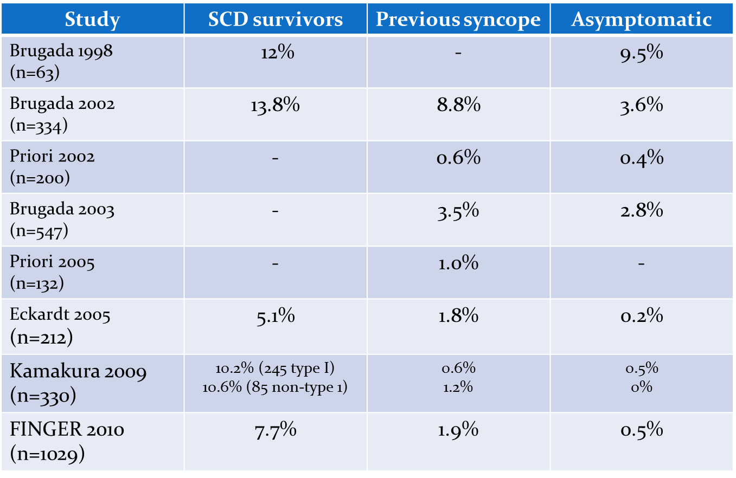
Annual event rates (SCD or documented VF) reported in published registries

Slide 55
Councelling and Follow up is no less important than an ICD
ICD implantation especially in a young patient is not without a significant price, with concern in risk of inappropriate therapy (due to sinus tachycardia, SVT, lead failure), lead complications and psychosocial impact in the many years to come.
It is imperative to discuss with the patient on implication of having an ICD (and EP testing to guide the treatment if plan to do so), versus expectant approach.
Regular re-evaluation is mandatory as phenotype changes with time and new data emerges

Slide 56
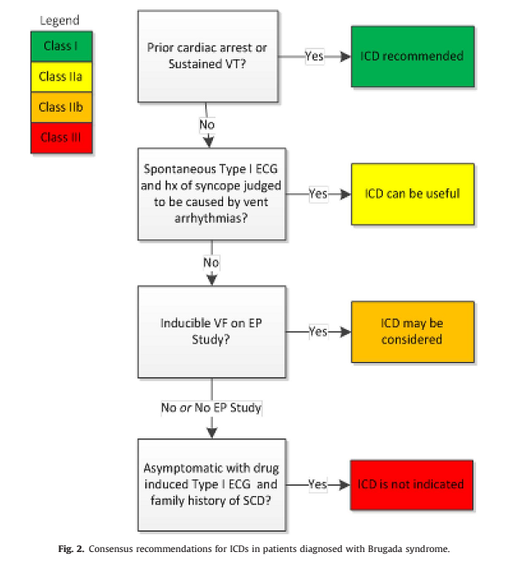
HRS/EHRA/APHRS Expert Consensus 2013
Recommendations on BrS therapeutic interventions

Slide 57
HRS/EHRA/APHRS Expert Consensus 2013
Recommendations on BrS therapeutic interventions
Class I
The following lifestyle changes are recommended in all patients with diagnosis of BrS:
  a. Avoidance of drugs that may induce or aggravate ST-segment elevation in right precordial leads (e.g., Brugadadrugs.org)
  b. Avoidance of excessive alcohol intake
  c. Immediate treatment of fever with antipyretic drugs.
ICD implantation is recommended in patients with a diagnosis of BrS who:
  a. Are survivors of a cardiac arrest and/or
  b. Have documented spontaneous sustained VT with or without syncope

Slide 58
HRS/EHRA/APHRS Expert Consensus 2013
Recommendations on BrS therapeutic interventions
Class IIa
ICD implantation can be useful in patients with a spontaneous diagnostic type I ECG who have a history of syncope judged to be likely caused by ventricular arrhythmias.
Quinidine can be useful in patients with a diagnosis of BrS and history of arrhythmic storms defined as more than two episodes of VT/VF in 24 hours.
Quinidine can be useful in patients with a diagnosis of BrS who:
  a. Qualify for an ICD but present a contraindication to the ICD or refuse it and/or
  b. Have a history of documented supraventricular arrhythmias that require treatment.
Isoproterenol infusion can be useful in suppressing arrhythmic storms in BrS patients

Slide 59
HRS/EHRA/APHRS Expert Consensus 2013
Recommendations on BrS therapeutic interventions
Class IIb
ICD implantation may be considered in patients with a diagnosis of BrS who develop VF during programmed electrical stimulation (inducible patients).
Quinidine may be considered in asymptomatic patients with a diagnosis of BrS with a spontaneous type I ECG.
Catheter ablation may be considered in patients with a diagnosis of BrS and history of arrhythmic storms or repeated appropriate ICD shocks

Slide 60
HRS/EHRA/APHRS Expert Consensus 2013
Recommendations on BrS therapeutic interventions
Class III
ICD implantation is not indicated in asymptomatic BrS patients with a drug-induced type I ECG and on the basis of a family history of sudden cardiac death (SCD) alone

Slide 61
conclusion
Since its description 20 years ago, clinical data of Brugada syndrome has been changing as the milder form of its phenotypes are included.
Nevertheless, risk stratification and management of asymptomatic subjects with Brugada pattern remains a clinical challenge, although the risk of event seems to be much lower than early description

Slide 62
Thank you……

